Slide 1
WELCOME

Slide 2

MET
Presentation on :- Examination System Project
Session :- 2017-2018
Submitted by:- supervision:-
Dr.Lobnna Abo El Maged
Mohamed Farid Amin Elkholy
Hisham Mahmoud ElAlawy
Mohamed Ebrahim abo El Hamed
Mahmoud Samir Abd El Samea

Slide 3
Examination System
Contents:-
Introduction
Problem definition
Problem Solution
Technology Used
Project Analysis And Design
Data Flow Diagram(DFD)
DataBase Diagram
ER Diagram (ERD)
Merits of project

Slide 4
Introduction
Examination system refers conduct to service as examination or test.
examination system will use in schools, colleges, universities.
Exam System is very useful for Educational Institute to prepare an exam, safe the time that will take to check the paper and prepare mark sheets. It will help the Institute to testing of students and develop their skills.

Slide 5
Problem Definition
The number of students has a large number of allowed access to the Wi-Fi network.
the ip change whenever the exam starts

Slide 6
Problem Solution
In the section on increasing the number of students to interact with the system by means of wifi, we will use accses point.
We provide user card number and password. The id is unique so its data will be secured.

Slide 7
Technology used
PHP (language)
Mysql
Android

Slide 8
Front end technology:-
HTML
CSS
JavaScribt(Jquery Lib)
4.Bootstrab
.

Slide 9
Back end technology:-
PHP:-
Mysql:-
Software Requirement:- (Any one(
WAMP Server
Apache
Phpmyadmin(mysql)
Hardware requirement :- Basic computer system and mobile and access point.

Slide 10
Project Analysis And Design
This project will complete in two module which are as follow:-
EXAMINATION SYSTEM
ADMIN
STUDENT

Slide 11
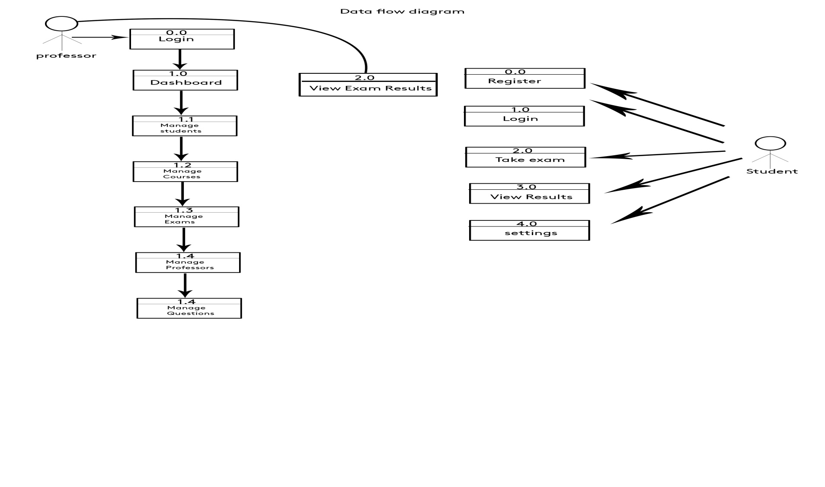
Data Flow Diagram(DFD):

Slide 12
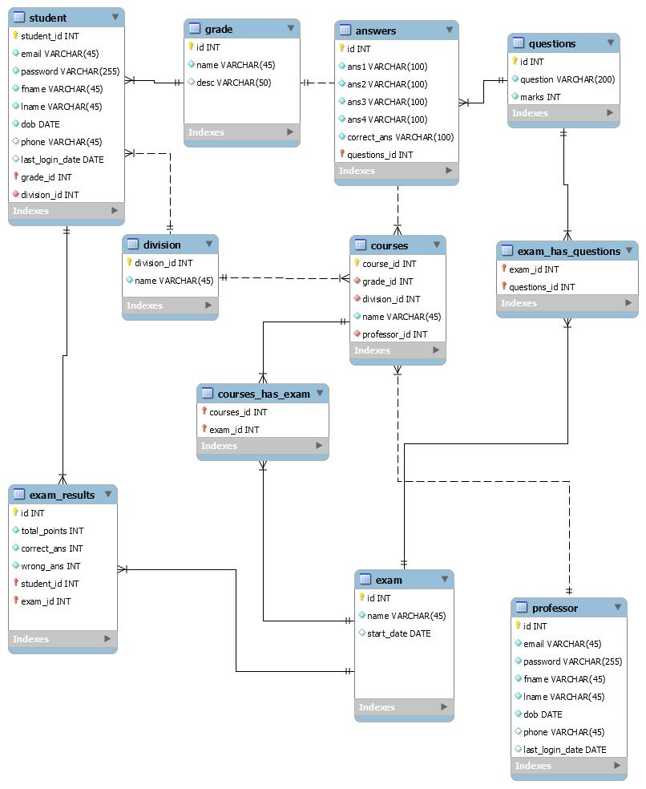
DataBase Diagram:

Slide 13
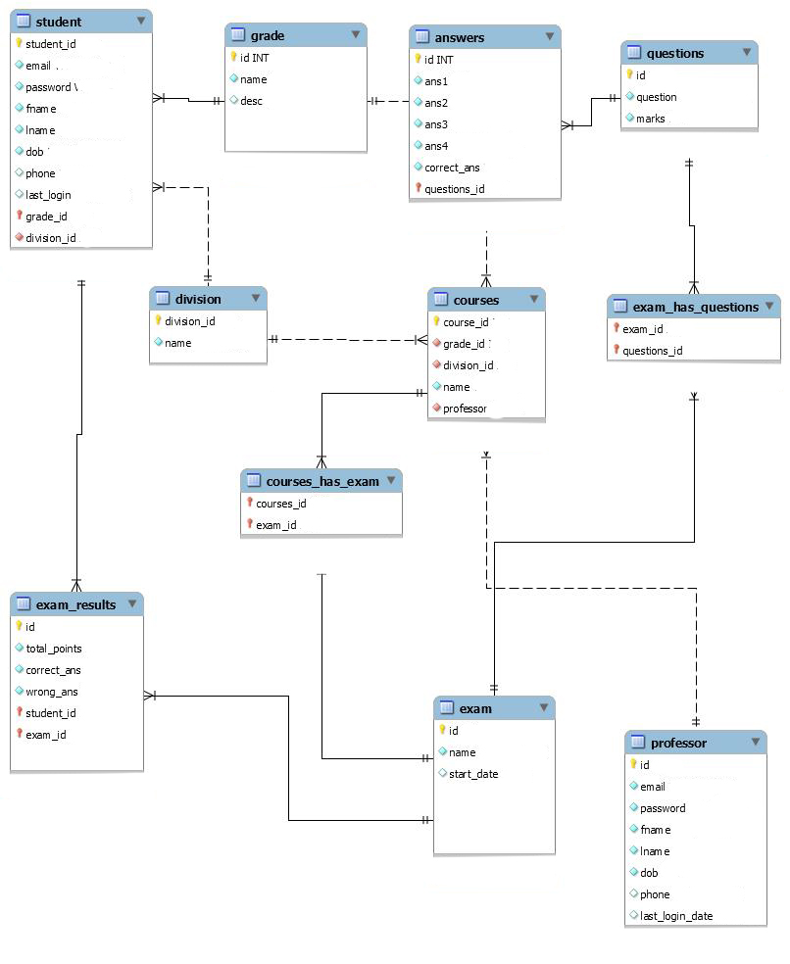
ER Diagram (ERD):

Slide 14
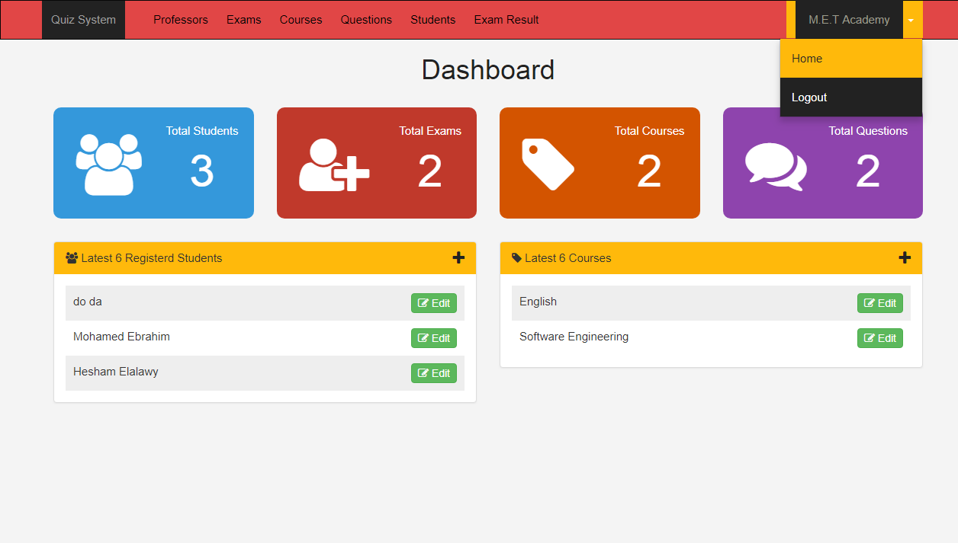
Home Page for Admin:-

Slide 15

Admin Aspects
Taking back up of the database.
Editing/deleting/creating the database.
Changing the password.
Logging into the system.
Posting question in the above test.
View a particular student and delete the student.
Show result of examination.

Slide 16
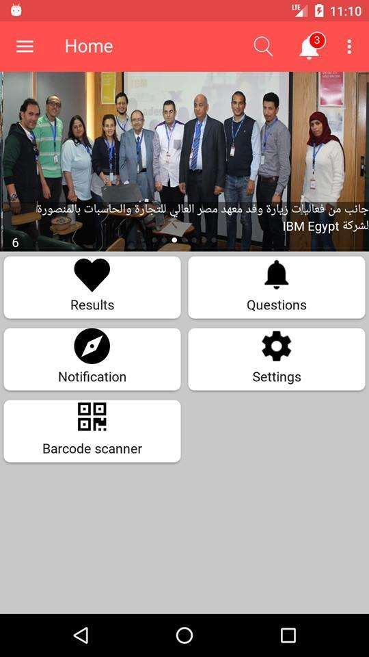
Home Page for student:-

Slide 17

Student Aspects
Read the instruction of accessing this site.
Request for registration.
See the notification for Test.
Logging into the system.
Appear the Test or Exam.
Find result at the end of exam

Slide 18
Merits of examination project
Auto grading.
Flexible.
Time saver.
Security.
The logs of appeared students and their marks are stored in database for future use.
Result will automatically generated by the android Application.
Administrator has a privilege to create,modify and delete the test.
Avoid the paper work.

Slide 19
THANK YOU
Thanks to you all for give opportunity to represent our project presentation in front of you all.

